Slide 1



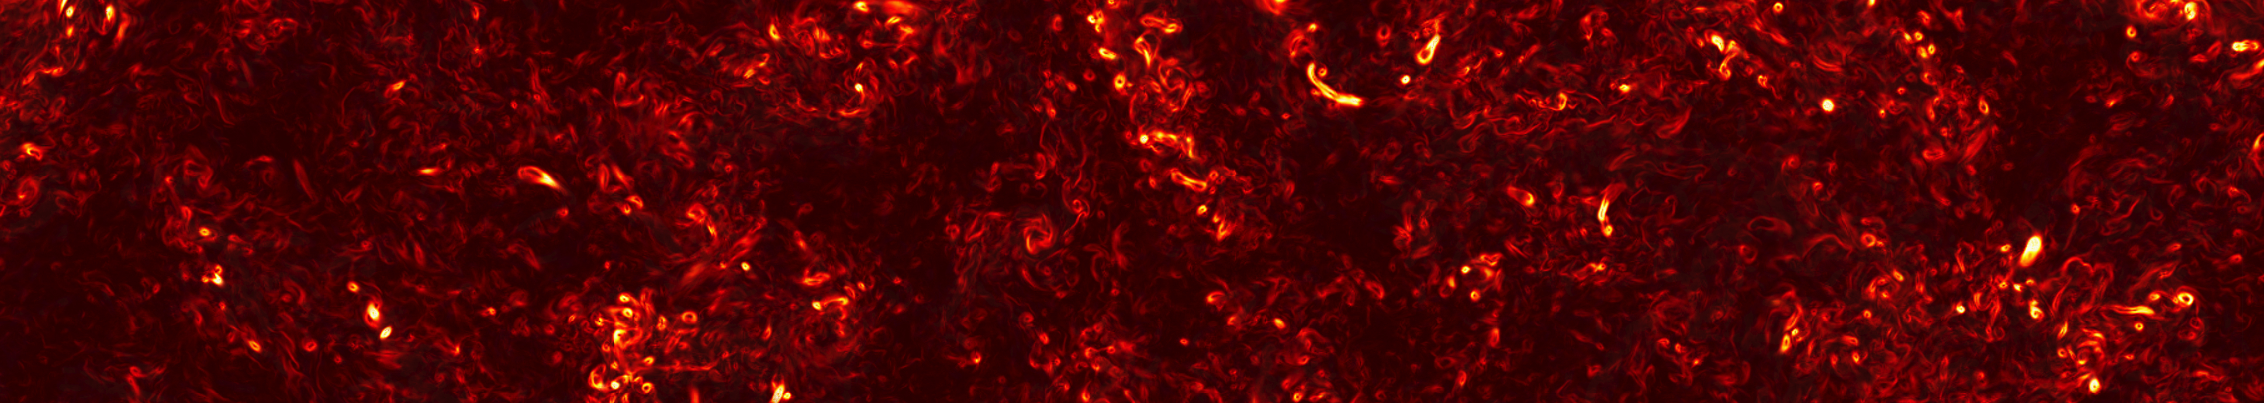
FLASH code
An open source tool for HEDP
Petros Tzeferacos
Flash Center, University of Chicago
LLE, 04/23/14

Slide 2
Outline
What is FLASH?
How do I get the code?
How do I “install” it?
What does it do?
How do I see what it does?
How do I simulate my own experiment?
Petros Tzeferacos
LLE, 04/23/14

Slide 3
Outline
What is FLASH?
How do I get the code?
How do I “install” it?
What does it do?
How do I see what it does?
How do I simulate my own experiment?
Petros Tzeferacos
LLE, 04/23/14

Slide 4
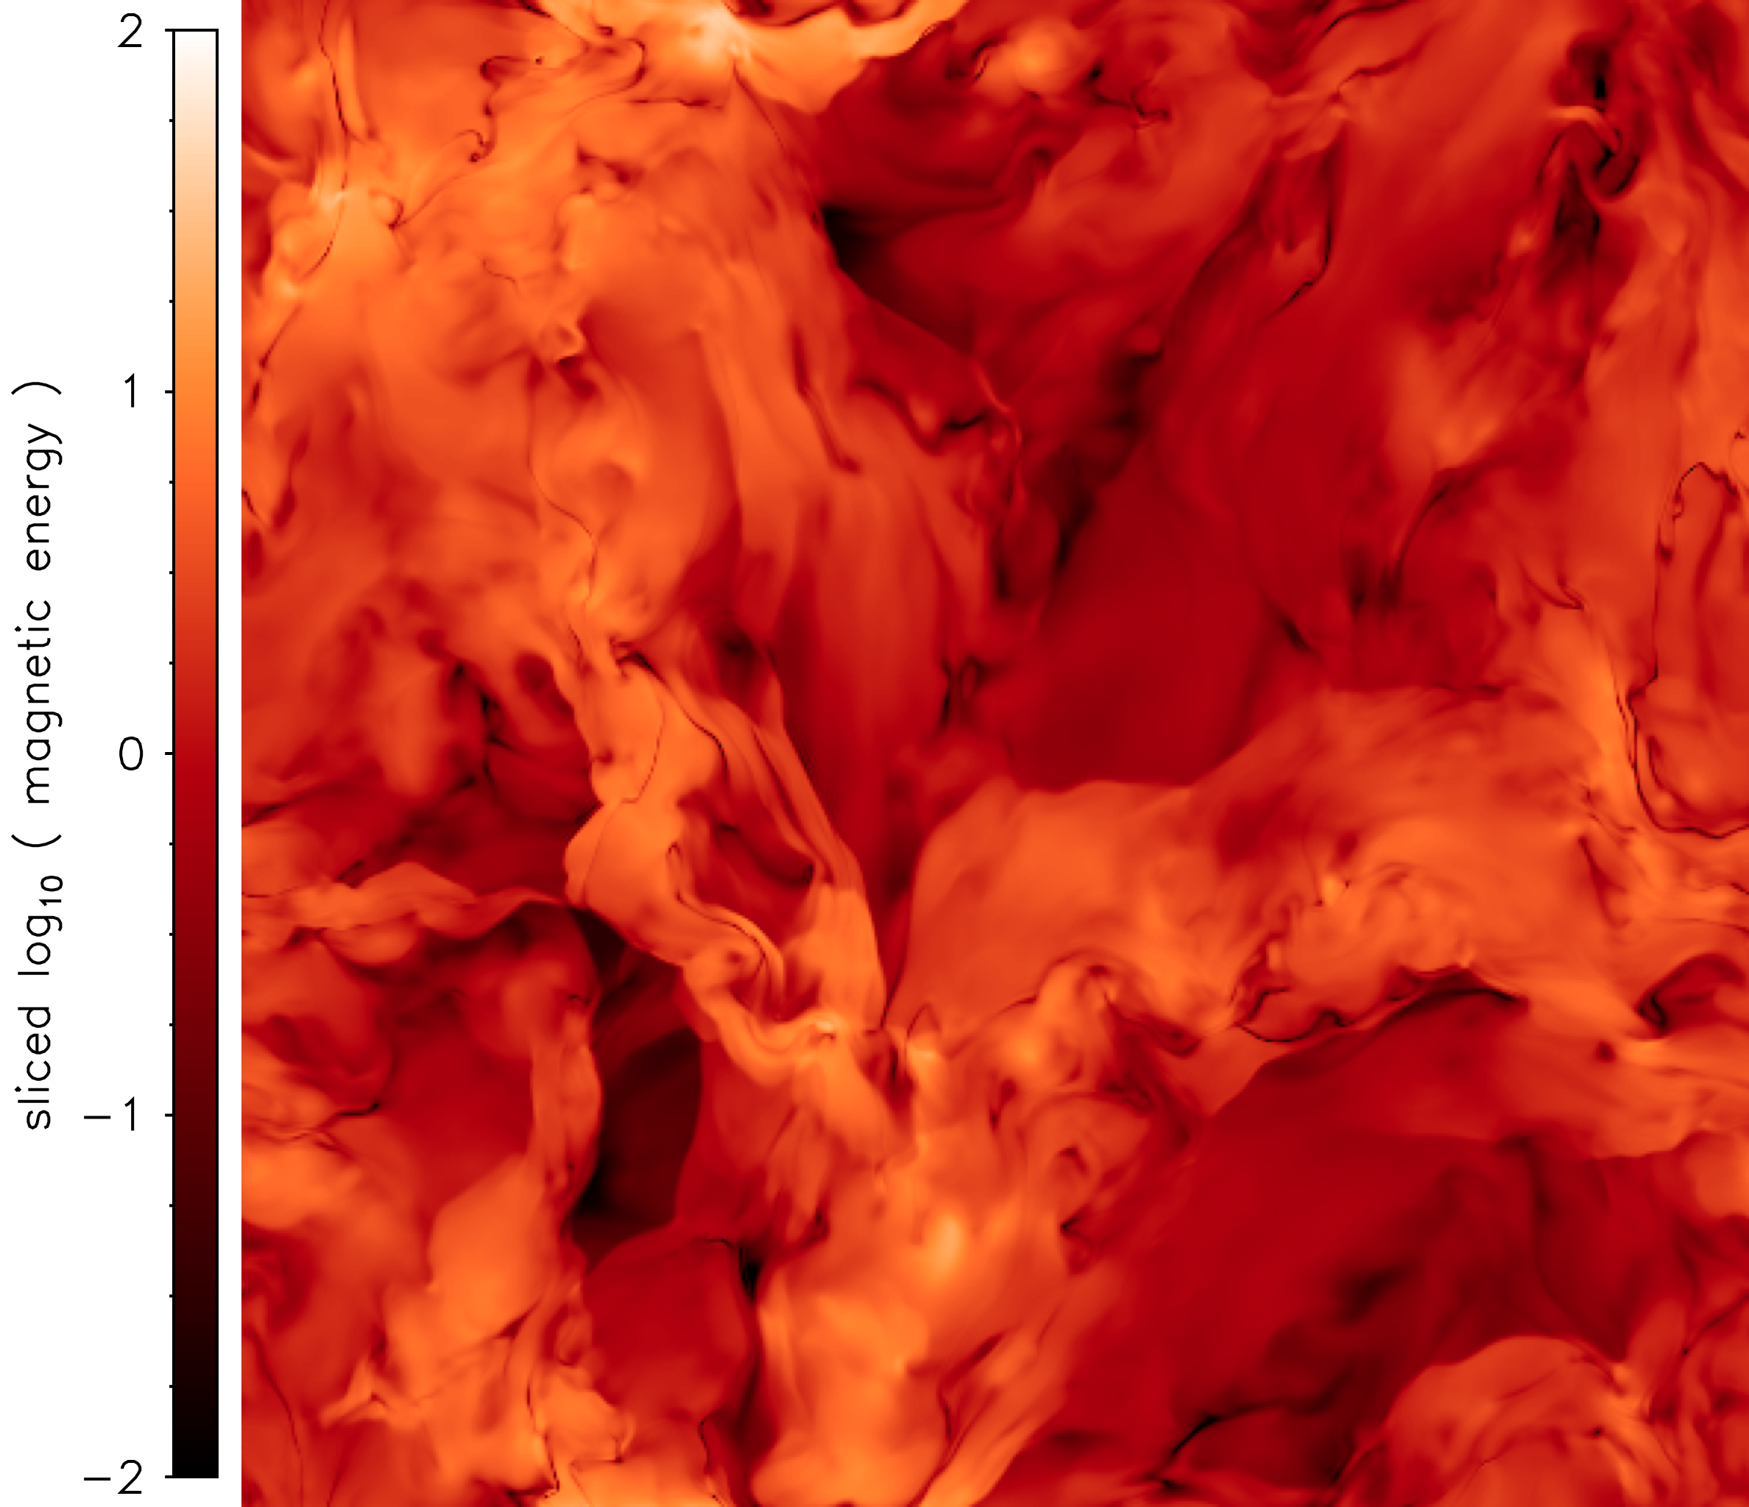
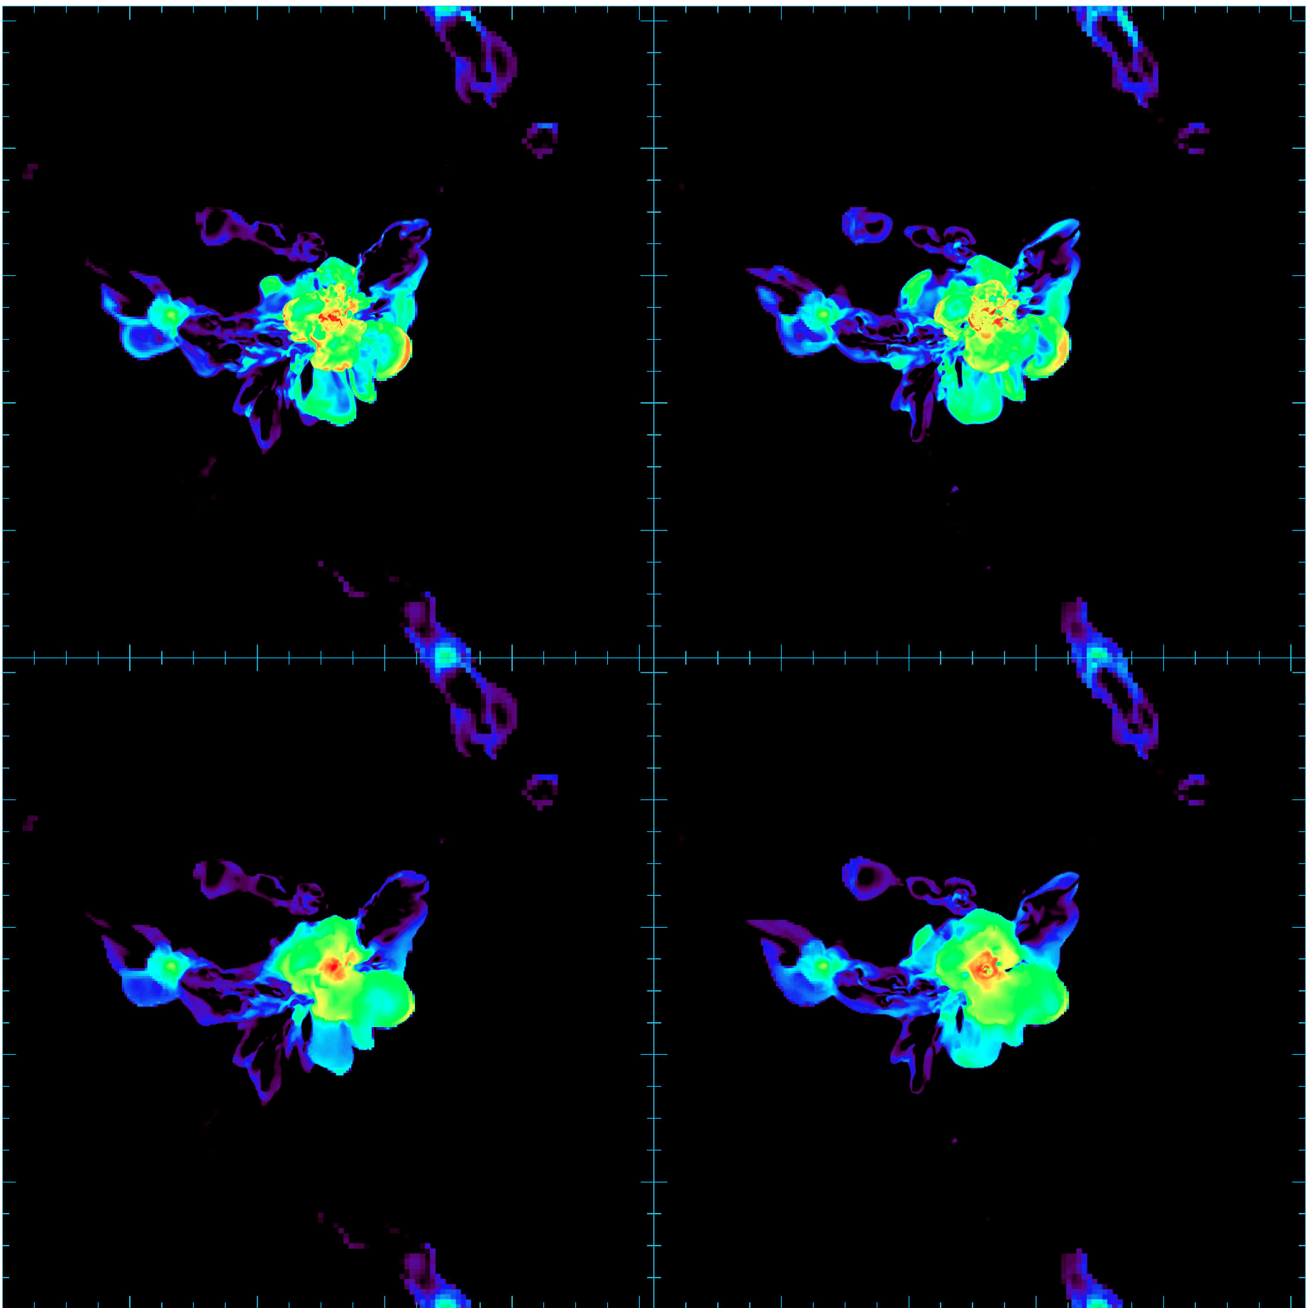
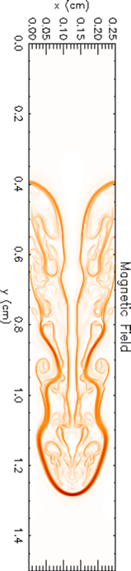
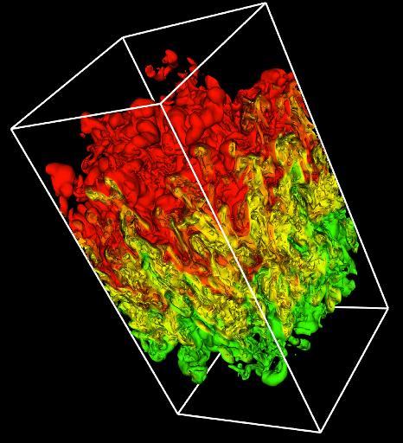
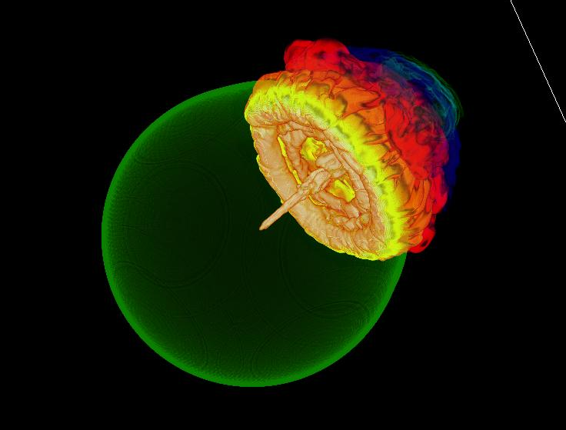
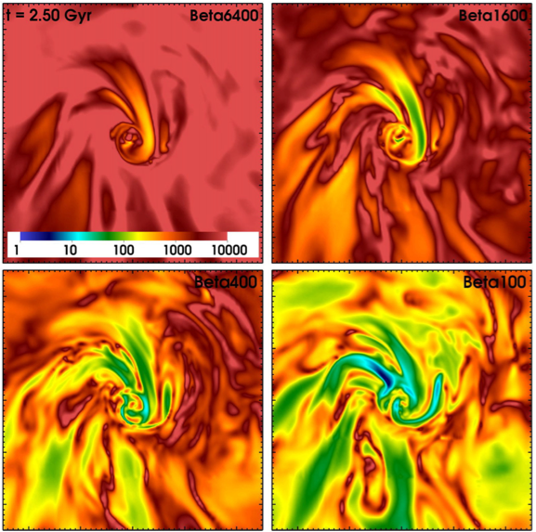
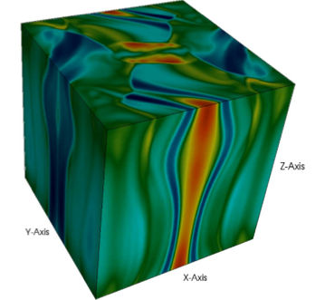
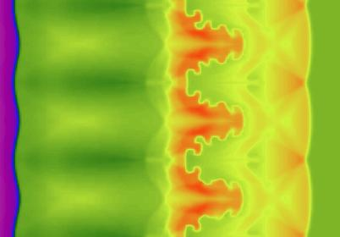
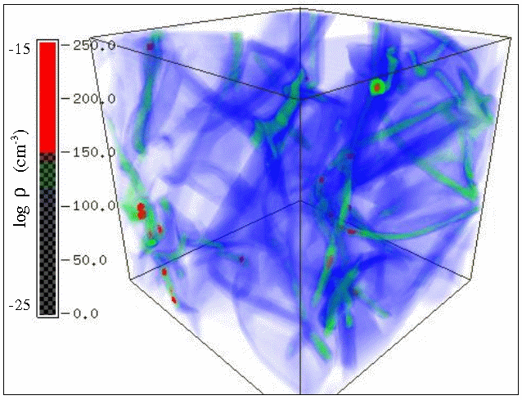
FLASH
Petros Tzeferacos
LLE, 04/23/14

Slide 5
The FLASH code
FLASH is an open source, adaptive mesh refinement,
finite-volume, compressible, Eulerian hydrodynamics and
magneto-hydrodynamics code with extended physics
capabilities
FLASH is professionally written and managed software
with:
  coding standards
  version control
  daily automated regression testing
  extensive documentation
  user support
  integration of extensive code contributions
  from external users
Petros Tzeferacos
LLE, 04/23/14

Slide 6
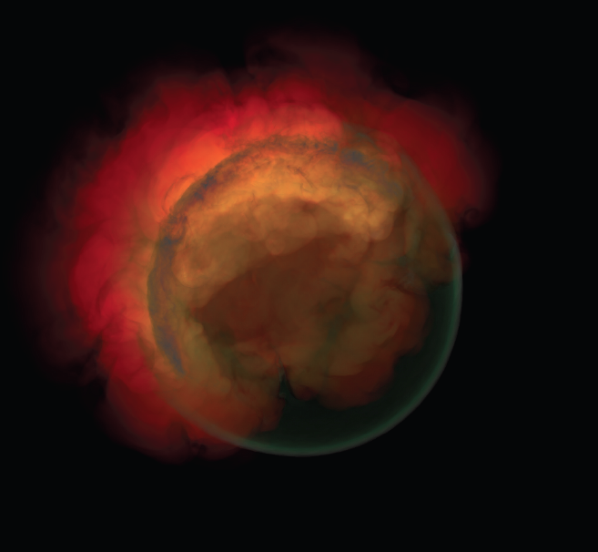
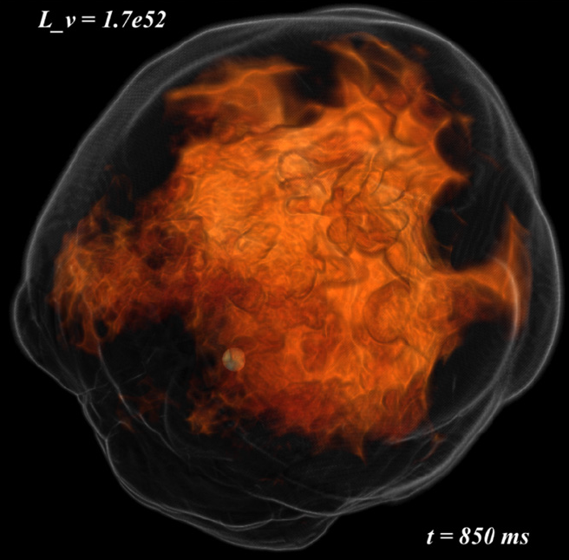
Stars
Failed Detonation Model to explain
underluminous Type IA (Jordan et al. 2013)
Neutrino-driven Core Collapse Supernova
(Couch 2013)
Petros Tzeferacos
LLE, 04/23/14

Slide 7
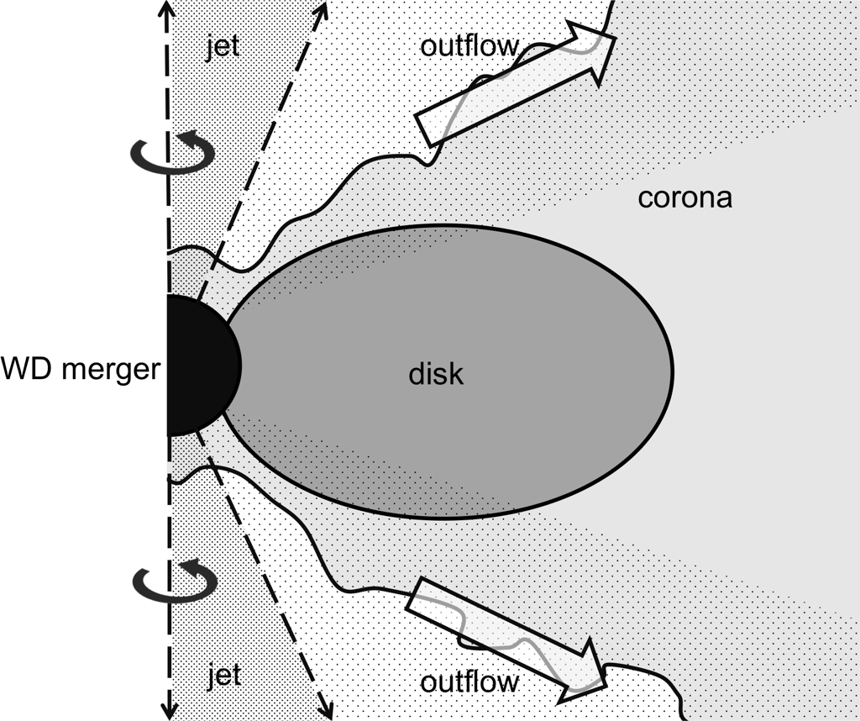
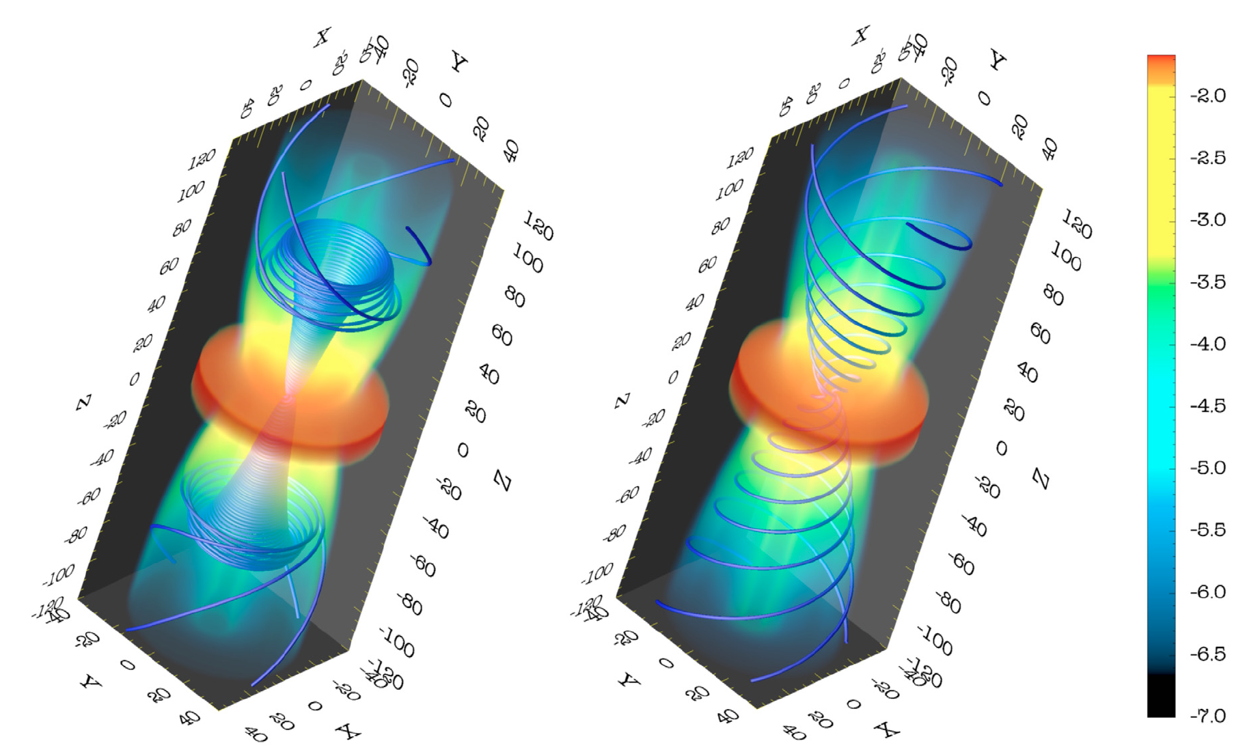
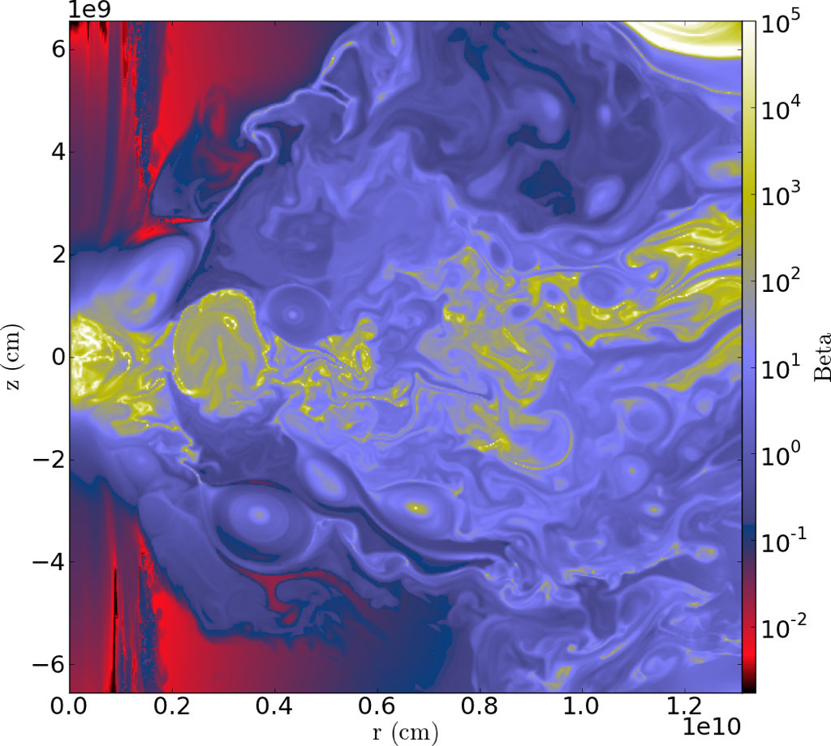
Disks and Jets
Magneto-centrifugal acceleration
(Zanni et al. 2007)
Magnetized post-merger evolution in
double-degenerate binaries (Ji et al. 2013)
Petros Tzeferacos
LLE, 04/23/14

Slide 8
The FLASH code
FLASH performs well on a wide range of platforms,
from laptops to massively parallel supercomputers
like the IBM BG/P and the IBM BG/Q at the Argonne
Leadership Computing Facility
The code has a large international user base spanning
a broad range of scientific fields
The FLASH communities in the U.S. and Europe
are particularly active and have contributed many
modules to the code
Petros Tzeferacos
LLE, 04/23/14

Slide 9
Scientific output
More than 800 papers have been published, either using FLASH or FLASH results
Petros Tzeferacos
LLE, 04/23/14

Slide 10
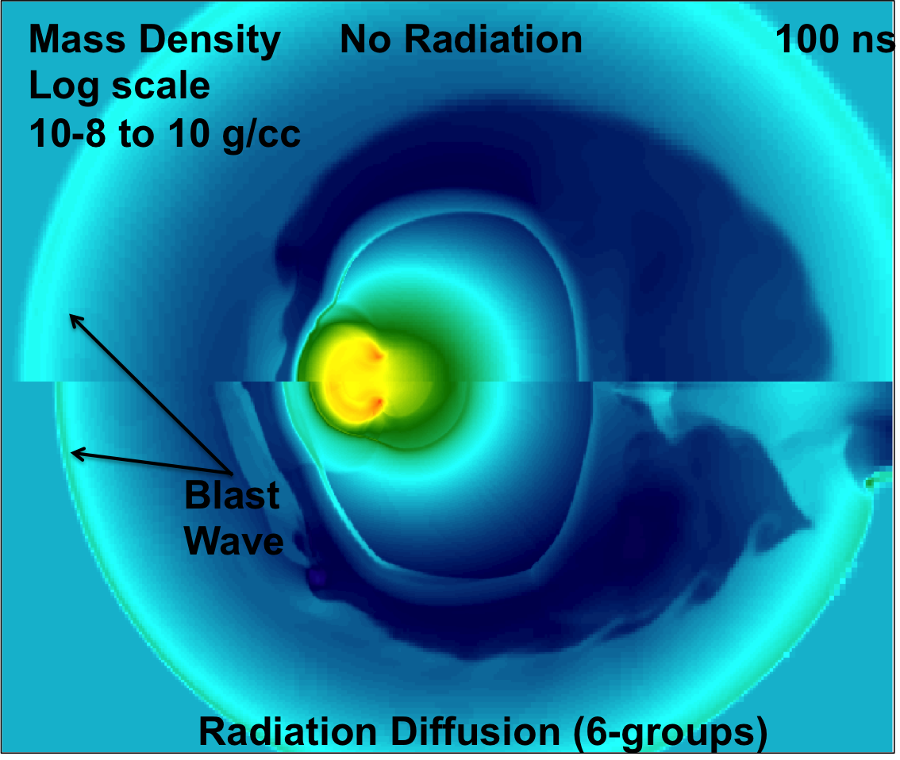
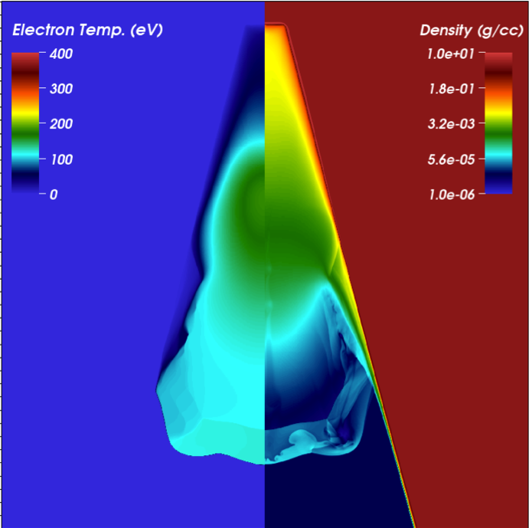
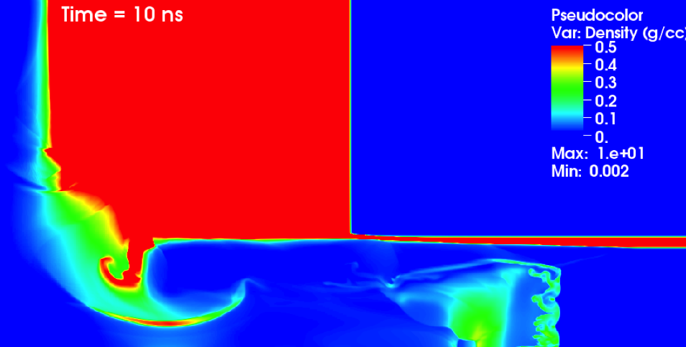
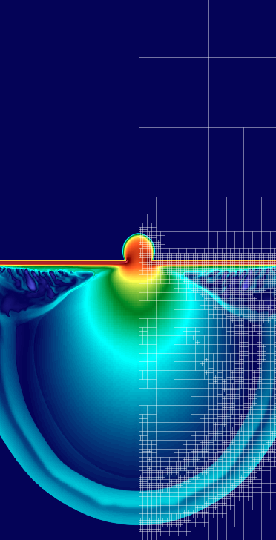
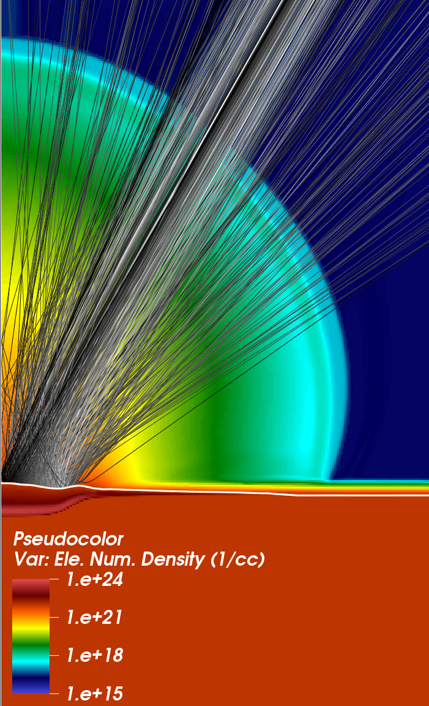
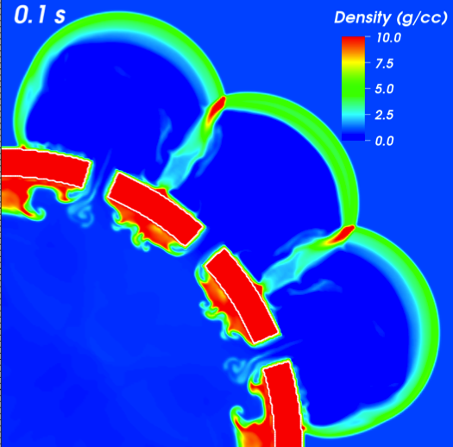
FLASH for HEDP and HEDLA
Petros Tzeferacos
LLE, 04/23/14

Slide 11
FLASH capabilities
A portable, scalable, application code, composed of units/modules
Modules are set up together to run different physics problems
Fortran, C, Python, >1.2 million lines, 75% code, 25% comments
Petros Tzeferacos
LLE, 04/23/14

Slide 12
FLASH capabilities
A portable, scalable, application code, composed of units/modules
Modules are set up together to run different physics problems
Fortran, C, Python, >1.2 million lines, 75% code, 25% comments
Infrastructure: Configuration, Mesh Management (Paramesh, Chombo), Parallel I/O, Monitoring, Verification
Petros Tzeferacos
LLE, 04/23/14

Slide 13
FLASH capabilities
A portable, scalable, application code, composed of units/modules
Modules are set up together to run different physics problems
Fortran, C, Python, >1.2 million lines, 75% code, 25% comments
Infrastructure: Configuration, Mesh Management (Paramesh, Chombo), Parallel I/O, Monitoring, Verification
Already in place for Astrophysics
  Hydro, MHD, RHD, hybrid PIC
  Equation of State
  Nuclear Physics, Source Terms
  External gravity, Self-gravity
  Particles, active and passive
  Material Properties
  Cosmology
Petros Tzeferacos
LLE, 04/23/14

Slide 14
FLASH capabilities
A portable, scalable, application code, composed of units/modules
Modules are set up together to run different physics problems
Fortran, C, Python, >1.2 million lines, 75% code, 25% comments
Infrastructure: Configuration, Mesh Management (Paramesh, Chombo), Parallel I/O, Monitoring, Verification
Already in place for Astrophysics
Developed for HEDP
  Hydro, MHD, RHD, hybrid PIC
  Equation of State
  Nuclear Physics, Source Terms
  External gravity, Self-gravity
  Particles, active and passive
  Material Properties
  Cosmology
    3T HD & MHD
    Heat exchange
    FL-MGD
    Laser energy deposition
    Implicit diffusion solver
    Spitzer-like resistivity, BBT
    Multi-material EoS
Petros Tzeferacos
LLE, 04/23/14

Slide 15
HEDP simulation community
Academic Institutions
Massachusetts Institute of Technology (Plasma Science and Fusion Center)
University of Michigan (Center for Radiation Shock Hydrodynamics)
Ohio State University (High Energy Density Physics Group)
Rice University (High Energy Density Laboratory Astrophysics Group)
University of Texas (High Intensity Laser Science Group)
University of Wisconsin (Fusion Technology Institute)
University of Oxford (High Energy Density Laboratory Astrophysics Group)
Universite’ Paris VI Ecole Polytechnique (High Energy Density Physics Group)
Petros Tzeferacos
LLE, 04/23/14

Slide 16
HEDP simulation community
National Laboratories
Rutherford-Appleton Laboratory
Laboratoire pour l’Utilisation de Lasers Intenses (LULI)
Los Alamos National Laboratory (code-to-code, EoS experiments)
Livermore National Laboratory (Biermann battery treatment)
Naval Research Laboratory (Radial implosion, Z-Pinch capabilities)
Petros Tzeferacos
LLE, 04/23/14

Slide 17
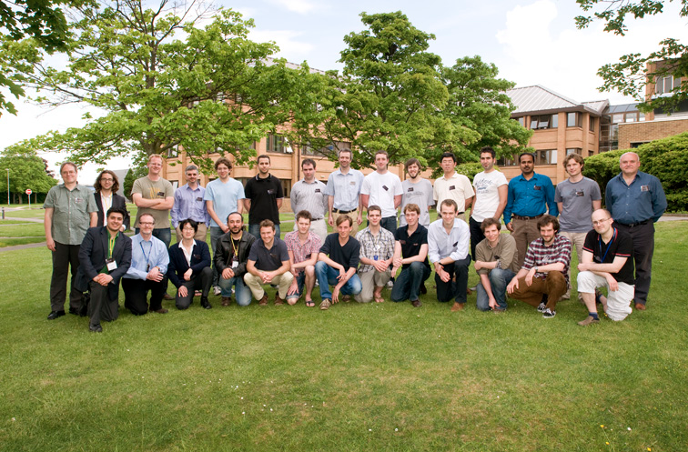
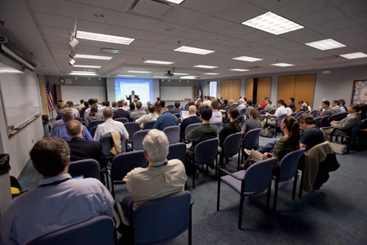
HEDP simulation community
Omega UG meeting
FLASH tutorial @ RAL
Petros Tzeferacos
LLE, 04/23/14

Slide 18
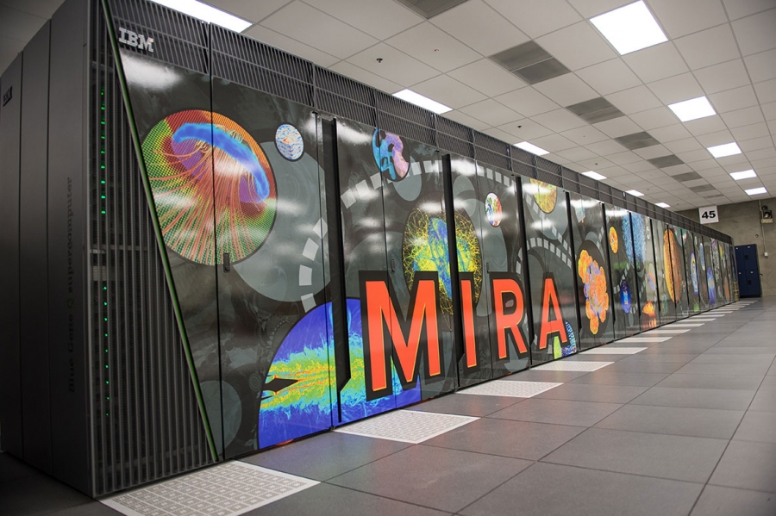
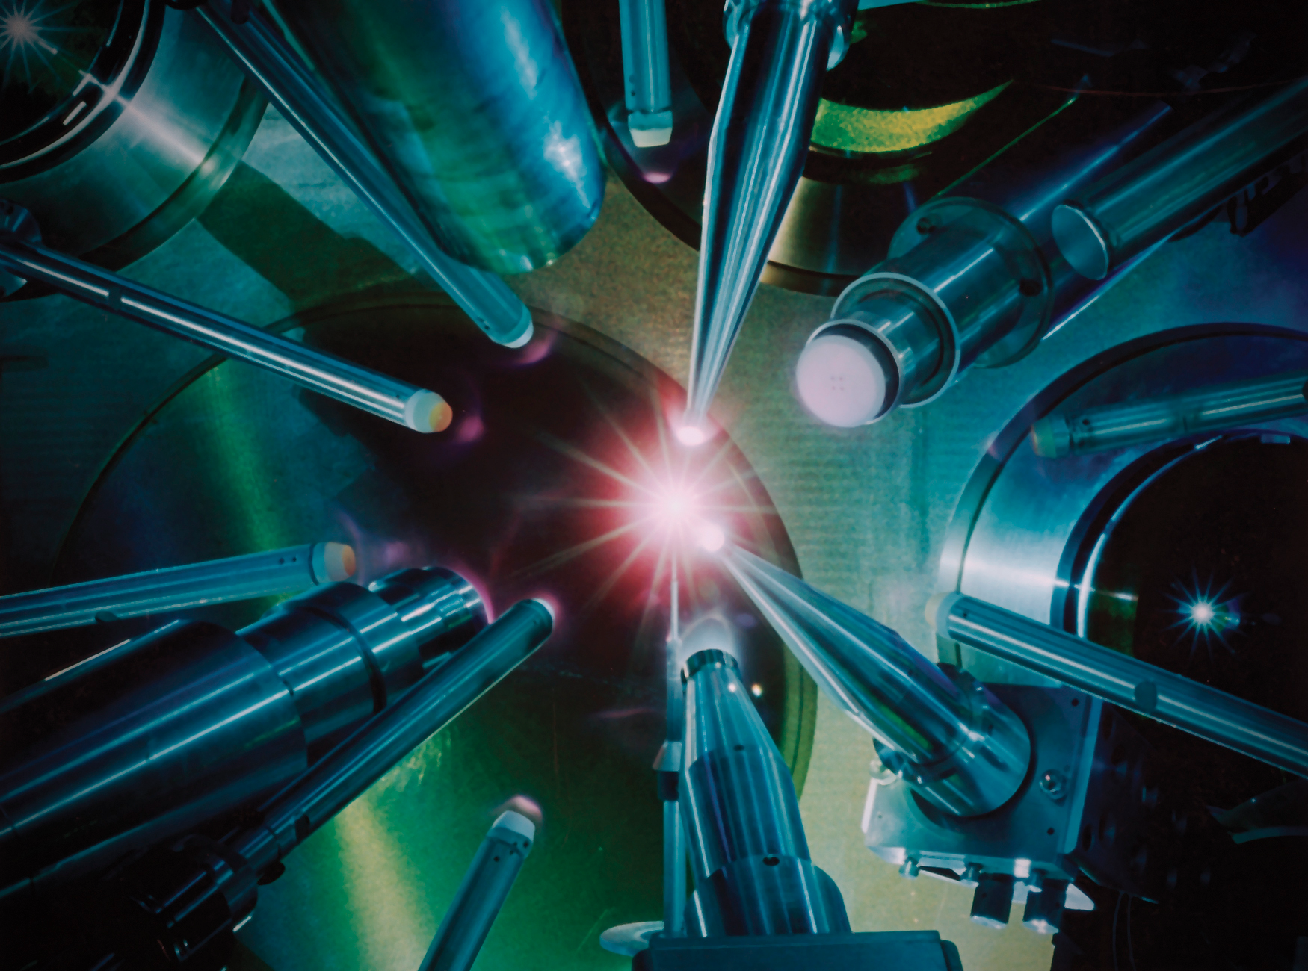
Bringing two worlds together
OMEGA laser at LLE
MIRA BG/Q at ALCF
Petros Tzeferacos
LLE, 04/23/14

Slide 19
Outline
What is FLASH?
How do I get the code?
How do I “install” it?
What does it do?
How do I see what it does?
How do I simulate my own experiment?
Petros Tzeferacos
LLE, 04/23/14

Slide 20
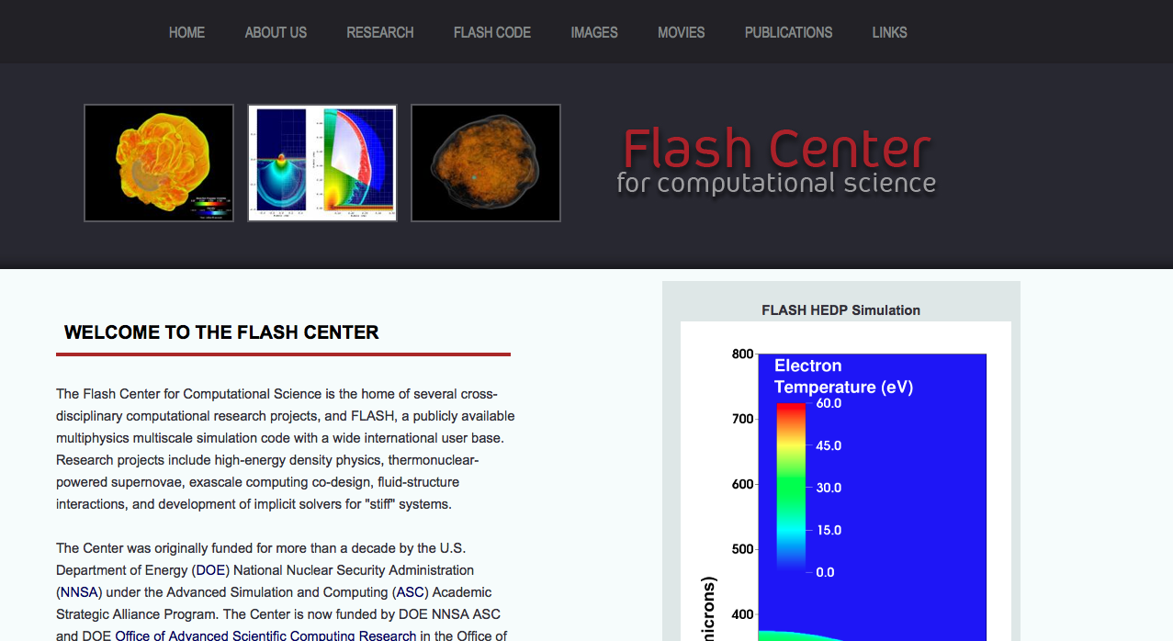
Flash Center webpage
http://flash.uchicago.edu
Petros Tzeferacos
LLE, 04/23/14

Slide 21
Flash Center webpage
http://flash.uchicago.edu
Petros Tzeferacos
LLE, 04/23/14

Slide 22
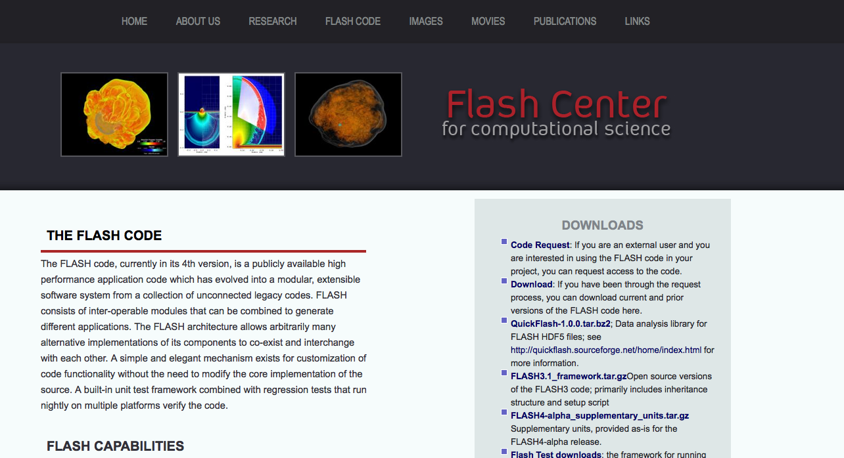
Flash Center webpage
http://flash.uchicago.edu
Petros Tzeferacos
LLE, 04/23/14

Slide 23
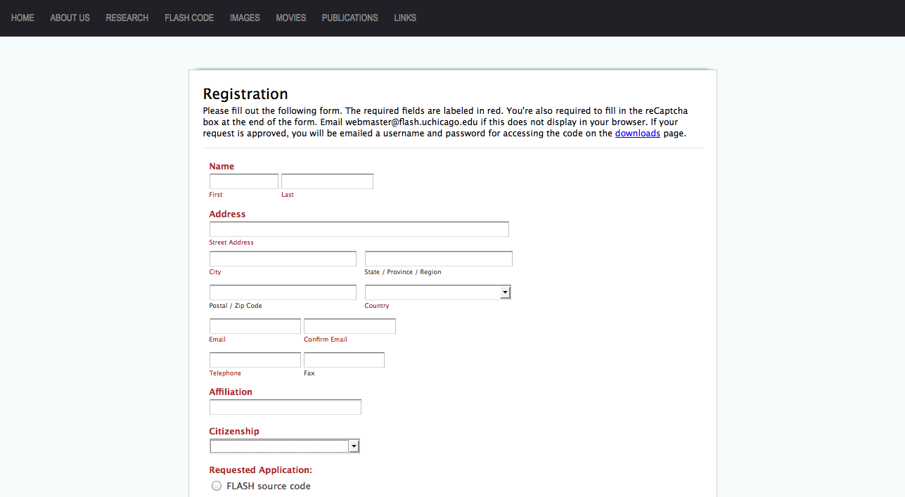
Flash Center webpage
http://flash.uchicago.edu
Petros Tzeferacos
LLE, 04/23/14

Slide 24

Flash Center webpage
You will receive an email from access@flash.uchicago.edu
with a password and a link to download the code.
Follow the instructions to obtain the source code
which is simply a compressed file...
FLASH.XX.tar
Petros Tzeferacos
LLE, 04/23/14

Slide 25
Outline
What is FLASH?
How do I get the code?
How do I “install” it?
What does it do?
How do I see what it does?
How do I simulate my own experiment?
Petros Tzeferacos
LLE, 04/23/14

Slide 26
Not an executable…
The tar-ball contains the source code, not an executable
It requires compilation and linking against libraries
You need to provide some environment dependencies
Some command line use and some file editing
Petros Tzeferacos
LLE, 04/23/14

Slide 27



Which OS flavor?
Usually..
Unix or Unix-like (e.g. Linux, Mac OS X, etc.)
- or -
Windows
Petros Tzeferacos
LLE, 04/23/14

Slide 28
Which OS flavor?
Usually..
Unix or Unix-like (e.g. Linux, Mac OS X, etc.)
- or -
Windows
Petros Tzeferacos
LLE, 04/23/14

Slide 29
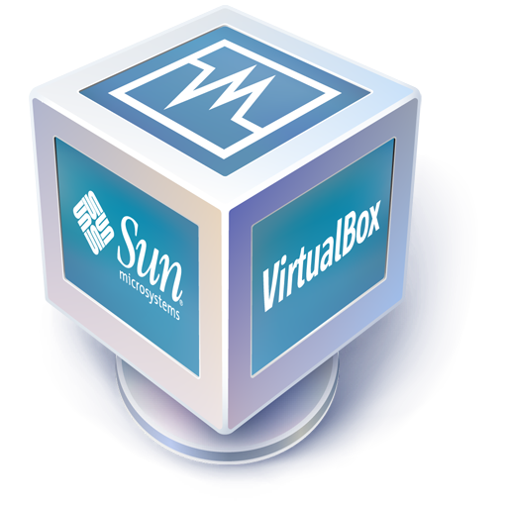
Open source virtual machines
Usually..
Unix or Unix-like (e.g. Linux, Mac OS X, etc.)
- or -
Windows
e.g.: virtualbox,
vmware, etc.
Petros Tzeferacos
LLE, 04/23/14

Slide 30
Dependencies (easy)
FLASH source code (the tar-ball)
F90 and C compilers (you probably have them already)
The GNU “gmake” utility (could have the alias “make”)
VisIt, software for data visualization (visit.llnl.gov)
MPI library for multi-core (MPICH, Open MPI) and
OpenMP for threading (you may have them already)
Python (you probably have it, or you can get it from
python.org)
Petros Tzeferacos
LLE, 04/23/14

Slide 31
Dependencies (a bit trickier)
HDF5, a library used by FLASH for I/O
http://www.hdfgroup.org/downloads/index.html
HYPRE, a library of preconditioners and solvers for the solution of large, sparse linear systems of equations, used by FLASH in MG-RD and parabolic solves. http://computation.llnl.gov/casc/hypre/software.html
These will need to be compiled on your machine
Petros Tzeferacos
LLE, 04/23/14

Slide 32
Unwrap our boxes
Create a work directory using the terminal:
> mkdir WorkDirectory
Untar FLASH:
> cp Downloads/FLASH.XX.tar ./WorkDirectory/
> cd WorkDirectory
> tar zvf FLASH.XX.tar
Do the same for HYPRE and HDF5 tar-balls, e.g.:
> cd ..
> cp Downloads/hdf5-1.8.10-patch1.tar.gz ./WorkDirectory/
> cd WorkDirectory
> tar xzvf hdf5-1.8.10-patch1.tar.gz
Petros Tzeferacos
LLE, 04/23/14

Slide 33
Compile our libraries
HDF5 (serial, e.g. in WorkDirectory/hdf5-1.8.10-patch1/)
> ./configure --prefix=/usr/local/lib/HDF5-serial
> make
> make install
HDF5 (parallel)
> CC = mpicc ./configure --prefix=/usr/local/lib/HDF5-parallel --enable-parallel
> make
> make install
HYPRE (e.g. in WorkDirectory/hypre-2.8.0b/)
> cd src
> ./configure --prefix=/usr/local/lib/HYPRE
> make install
Petros Tzeferacos
LLE, 04/23/14

Slide 34
Tell FLASH where things are
The Makefile.h file stores the information that FLASH will need in compilation time, essentially paths to the dependencies we discussed.
In the FLASH/sites/ directory make a directory of your own with your customized makefile. (copy an existing makefile and then edit it to reflect your environment.)
You can easily locate paths with the which command:
> which gcc
/usr/bin/gcc
What was described up until now is done once. You can now take full advantage of the code!
Petros Tzeferacos
LLE, 04/23/14

Slide 35
Outline
What is FLASH?
How do I get the code?
How do I “install” it?
What does it do?
How do I see what it does?
How do I simulate my own experiment?
Petros Tzeferacos
LLE, 04/23/14

Slide 36
The FLASH framework
An application code, composed of units/modules. Particular modules are set up together to run different physics problems.
Capabilities
Infrastructure
  Configuration (setup)
  Mesh Management
  Parallel I/O
  Monitoring
    (Performance and progress)
  Verification
    (FlashTest, Unit and regression testing)
Physics
  Hydrodynamics, MHD, RHD
  Equation of State
  Nuclear Physics
  Radiation Diffusion
  Laser Drive
  Gravity
  Particles, active and passive
  Material Properties
    (Opacities, Conductivity, Resistivity…)
  Cosmology
Petros Tzeferacos
LLE, 04/23/14

Slide 37
The FLASH framework
FLASH basic architecture unit
  Component of the FLASH code providing a particular functionality
  Different combinations of units are used for particular problem setups
  Publishes a public interface (API) for other units’ use.
  E.g.: Driver, Grid, Hydro, IO etc.
Fake inheritance by use of directory structure
Interaction between units governed by the Driver
Not all units are included in all applications
Petros Tzeferacos
LLE, 04/23/14

Slide 38
The FLASH framework
Infrastructure
Grid
Runtime
Params
I/O
Physics
Monitoring
Hydro
MHD
Profiling
Driver
Gravity
Burn
Logfile
Simulation
Petros Tzeferacos
LLE, 04/23/14

Slide 39
The FLASH framework
Infrastructure
Grid
Runtime
Params
I/O
Physics
Monitoring
Hydro
MHD
Profiling
Driver
Gravity
Burn
Logfile
Simulation
Petros Tzeferacos
LLE, 04/23/14

Slide 40
In a simulation…
Goal: evolve an initial condition in time
Solve numerically a system of equations e.g. MHD
Petros Tzeferacos
LLE, 04/23/14

Slide 41
In a simulation…
Goal: evolve an initial condition in time
Solve numerically a system of equations e.g. MHD
Non linear…
Petros Tzeferacos
LLE, 04/23/14

Slide 42
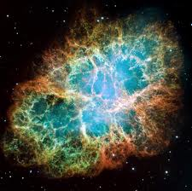
Example: RT instability
Filament structures in SN remnants!
Petros Tzeferacos
LLE, 04/23/14

Slide 43
Example: RT instability
Filament structures in SN remnants!
Petros Tzeferacos
LLE, 04/23/14

Slide 44
Example: RT instability
Filament structures in SN remnants!
Motivation:
Probably caused by the
Rayleigh-Taylor instability.
Simple model:
Two fluids of different
density inside a gravitational
Potential.
Petros Tzeferacos
LLE, 04/23/14

Slide 45
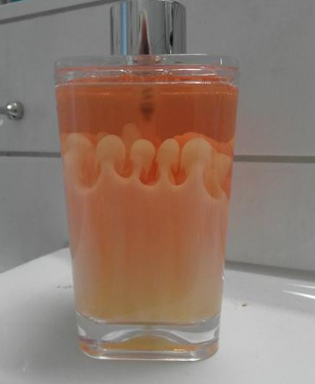
Example: RT instability
Filament structures in SN remnants!
Motivation:
Probably caused by the
Rayleigh-Taylor instability.
Simple model:
Two fluids of different
density inside a gravitational
Potential.
Petros Tzeferacos
LLE, 04/23/14

Slide 46
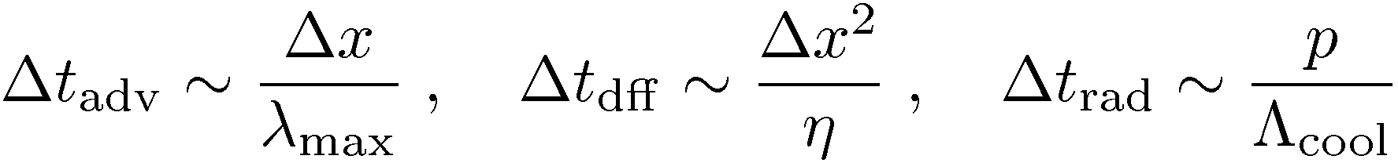
Example: RT instability
Before starting, go through a
short checklist:
Timescales of the problem?
Normalize (or don’t)
Resolution: What features do you want to see?
Non dimensional parameters are your knobs!
Plasma β, Mach number, density contrasts, etc.
Petros Tzeferacos
LLE, 04/23/14

Slide 47
Example: RT instability
Simulate a single filament in a Cartesian
“domain”. Mesh resolution? Physical size?
y
x
Petros Tzeferacos
LLE, 04/23/14

Slide 48
Example: RT instability
Simulate a single filament in a Cartesian
“domain”. Mesh resolution? Physical size?
Physics: Hydrodynamics + Gravity
(uniform gravity, in the y direction)
g
y
x
Petros Tzeferacos
LLE, 04/23/14

Slide 49
Example: RT instability
Simulate a single filament in a Cartesian
“domain”. Mesh resolution? Physical size?
Physics: Hydrodynamics + Gravity
(uniform gravity, in the y direction)
Initial value problem: Dense gas on top,
light bellow.
ρ₁
g
ρ₂
y
x
Petros Tzeferacos
LLE, 04/23/14

Slide 50
Example: RT instability
yr
Simulate a single filament in a Cartesian
“domain”. Mesh resolution? Physical size?
Physics: Hydrodynamics + Gravity
(uniform gravity, in the y direction)
Initial value problem: Dense gas on top,
light bellow.
Boundary conditions for the domain
borders: periodic (xl,xr), reflective (yl,yr)
ρ₁
g
xl
xr
ρ₂
y
x
yl
Petros Tzeferacos
LLE, 04/23/14

Slide 51
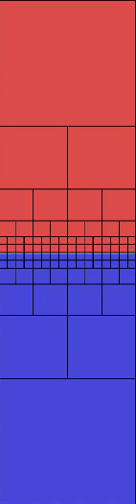
Example: RT instability
Simulate a single filament in a Cartesian
“domain”. Mesh resolution? Physical size?
Physics: Hydrodynamics + Gravity
(uniform gravity, in the y direction)
Initial value problem: Dense gas on top,
light bellow.
Boundary conditions for the domain
borders: periodic (xl,xr), reflective (yl,yr)
Crunch numbers!
Petros Tzeferacos
LLE, 04/23/14

Slide 52
When 1T is not enough…
In HEDP experiments single-temperature is not sufficient:
Shock heating of ions, laser heating of electrons, evaluation of transport coefficients, large equilibration timescales, realistic EoS, …
Petros Tzeferacos
LLE, 04/23/14

Slide 53
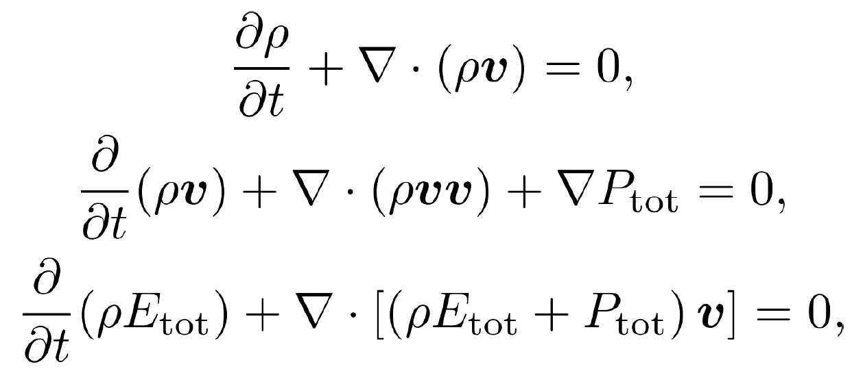
Three-temperature
In HEDP experiments single-temperature is not sufficient:
Shock heating of ions, laser heating of electrons, evaluation of transport coefficients, large equilibration timescales, realistic EoS, …
Continuity
Momentum
Hyperbolic system
Energy
Petros Tzeferacos
LLE, 04/23/14

Slide 54
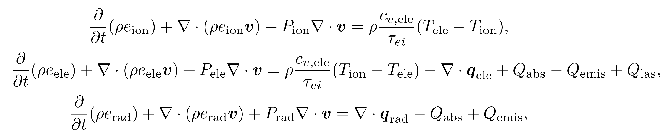
Three-temperature
In HEDP experiments single-temperature is not sufficient:
Shock heating of ions, laser heating of electrons, evaluation of transport coefficients, large equilibration timescales, realistic EoS, …
Continuity
Momentum
Hyperbolic system
Energy
Petros Tzeferacos
LLE, 04/23/14

Slide 55
Three-temperature
In HEDP experiments single-temperature is not sufficient:
Shock heating of ions, laser heating of electrons, evaluation of transport coefficients, large equilibration timescales, realistic EoS, …
Continuity
Momentum
Hyperbolic system
Energy
Petros Tzeferacos
LLE, 04/23/14

Slide 56
Three-temperature
In HEDP experiments single-temperature is not sufficient:
Shock heating of ions, laser heating of electrons, evaluation of transport coefficients, large equilibration timescales, realistic EoS, …
Continuity
Momentum
Hyperbolic system
Energy
Petros Tzeferacos
LLE, 04/23/14

Slide 57
Three-temperature
In HEDP experiments single-temperature is not sufficient:
Shock heating of ions, laser heating of electrons, evaluation of transport coefficients, large equilibration timescales, realistic EoS, …
Continuity
Momentum
Hyperbolic system
Energy
Petros Tzeferacos
LLE, 04/23/14

Slide 58
Three-temperature
In HEDP experiments single-temperature is not sufficient:
Shock heating of ions, laser heating of electrons, evaluation of transport coefficients, large equilibration timescales, realistic EoS, …
Continuity
Momentum
Hyperbolic system
Energy
Petros Tzeferacos
LLE, 04/23/14

Slide 59
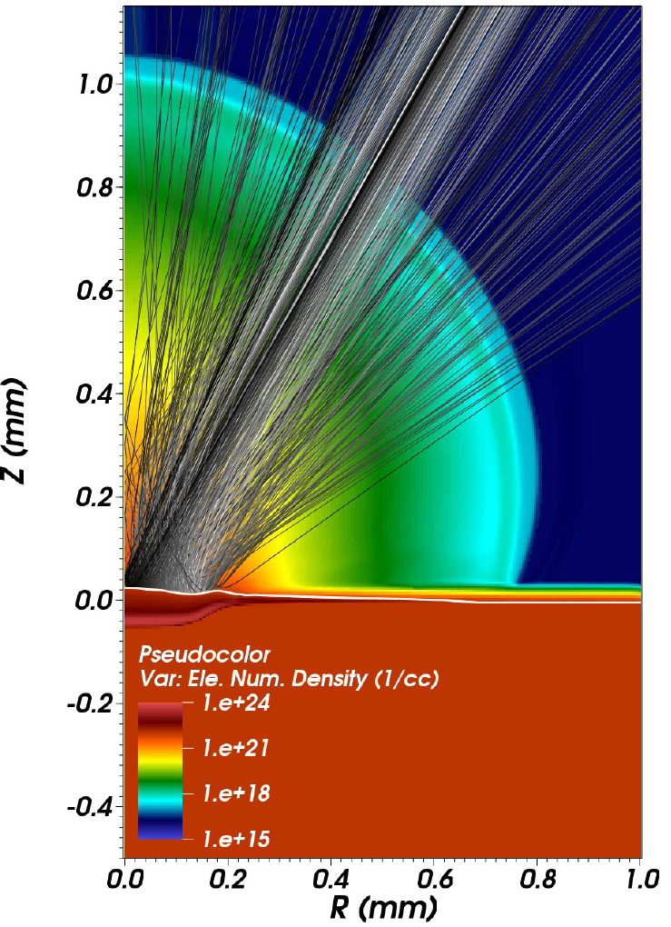
Energy deposition
FLASH sports a laser ray trace algorithm based on Kaiser (2000) and we are currently implementing more accurate algorithms
The laser beams are fully configurable, allowing for different spot sizes, wavelengths, intensity time profiles and directionality
3D-in-2D modeling of rays
Petros Tzeferacos
LLE, 04/23/14

Slide 60
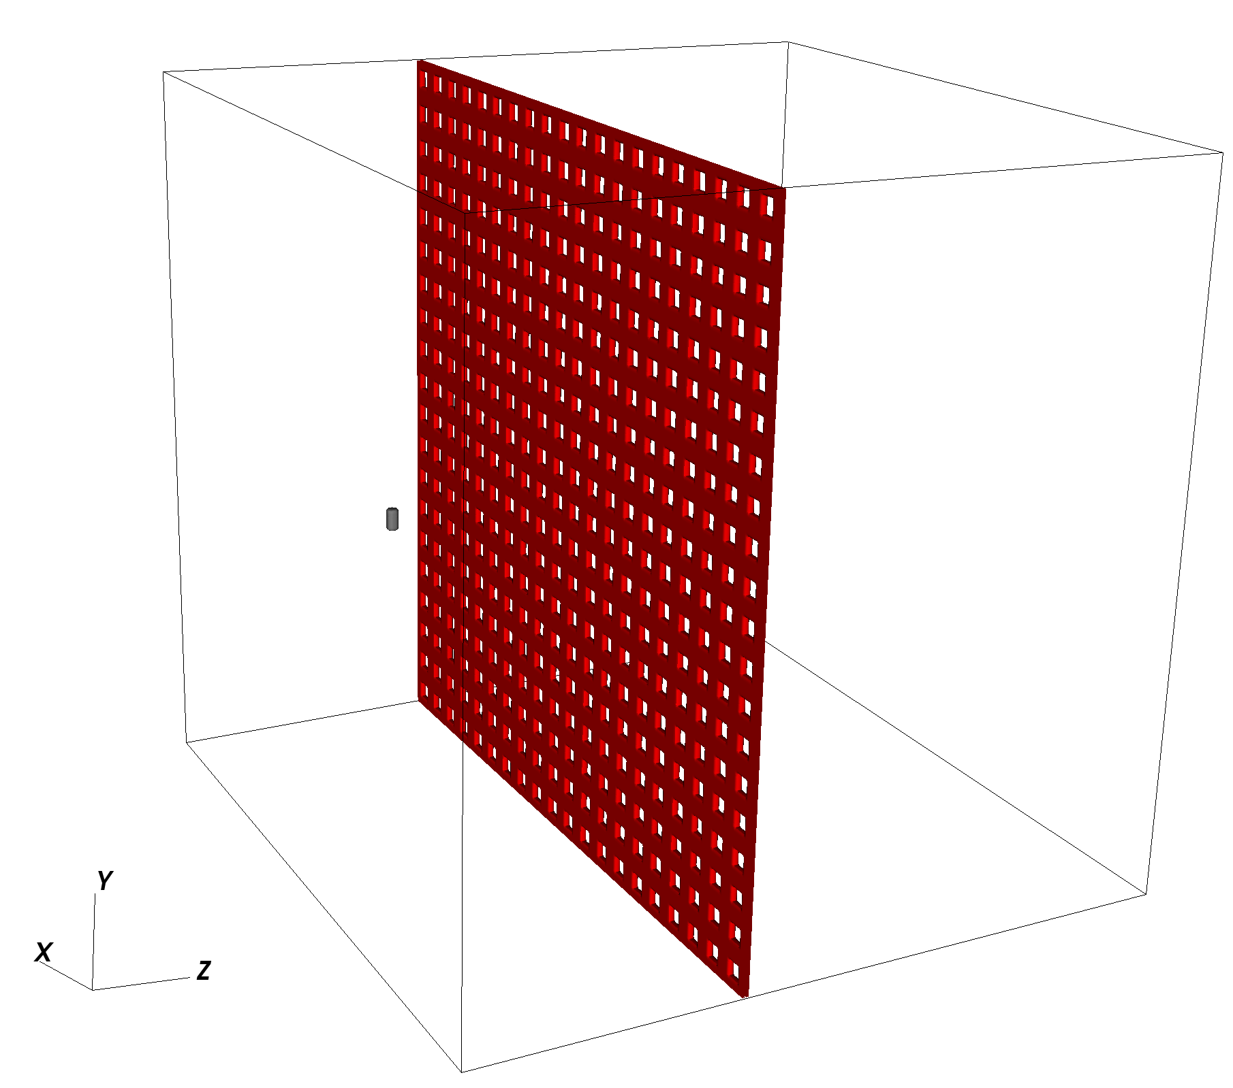
Combining Units
More complicated configurations are possible: e.g. laser driven shocks that generate magnetic fields + turbulence (Meinecke et al. 2014)
grid
carbon rod
Bdot
laser drive
Petros Tzeferacos
LLE, 04/23/14

Slide 61
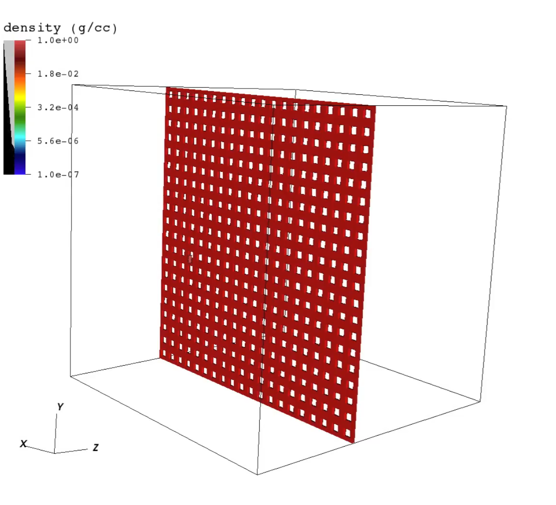
Combining Units
More complicated configurations are possible: e.g. laser driven shocks that generate magnetic fields + turbulence (Meinecke et al. 2014)
Petros Tzeferacos
LLE, 04/23/14

Slide 62
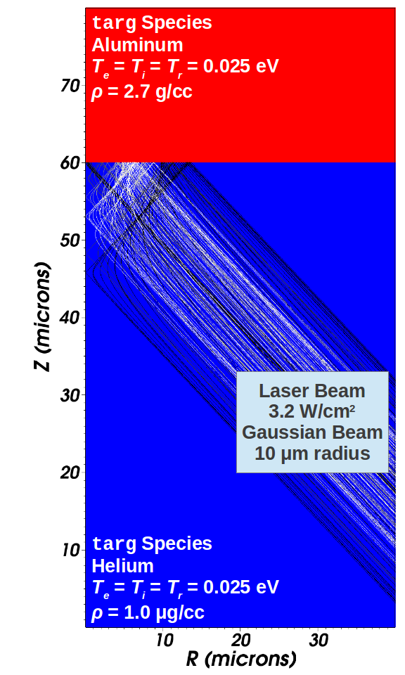
Laser-Slab
Let’s try to run an HEDP related test with FLASH. This configuration is provided in the release!
A simple laser beam illuminates an Aluminum slab inside Helium gas. We want to monitor the ablation for 3 ns.
It can be found in the code’s tree under
source/Simulation/SimulationMain/LaserSlab
Petros Tzeferacos
LLE, 04/23/14

Slide 63
Laser-Slab
It’s a three-step process:
- setup (pull in necessary units from the code)
> ./setup -auto LaserSlab -2d -nxb=16 -nyb=16 +hdf5typeio species=cham,targ +mtmmmt +laser +uhd3t +mgd mgd_meshgroups=6 -parfile=example.par
- compile (create the executable)
> make (or make –j4 to use more processors)
- run the simulation
> ./flash4 (or mpirun –np 4 ./flash4 to use more processors, req. MPI)
Petros Tzeferacos
LLE, 04/23/14

Slide 64
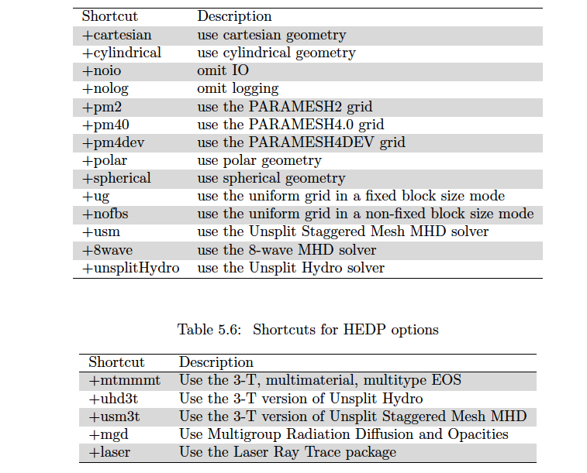
Shortcut-cheat sheet
Petros Tzeferacos
LLE, 04/23/14

Slide 65
flash.par
the flash.par file controls runtime parameters
let’s take a look…
Petros Tzeferacos
LLE, 04/23/14

Slide 66
Outline
What is FLASH?
How do I get the code?
How do I “install” it?
What does it do?
How do I see what it does?
How do I simulate my own experiment?
Petros Tzeferacos
LLE, 04/23/14

Slide 67
Data analysis and visualization
Any software capable of accessing HDF5 files can be used to analyze the data. In practice the main contenders are:
  VisIt (freely available, visit.llnl.gov)
  IDL (proprietary but license is usually available, exelisvis.com/ProductsServices/IDL.aspx)
  yt + matplotlib (publicly available, yt-project.org)
A number of scripts and GUI/widgets are available to load and manipulate data with the released code
Petros Tzeferacos
LLE, 04/23/14

Slide 68
Data analysis and visualization
Any software capable of accessing HDF5 files can be used to analyze the data. In practice the main contenders are:
  VisIt (freely available, visit.llnl.gov)
  IDL (proprietary but license is usually available, exelisvis.com/ProductsServices/IDL.aspx)
  yt + matplotlib (publicly available, yt-project.org)
A number of scripts and GUI/widgets are available to load and manipulate data with the released code
Petros Tzeferacos
LLE, 04/23/14

Slide 69
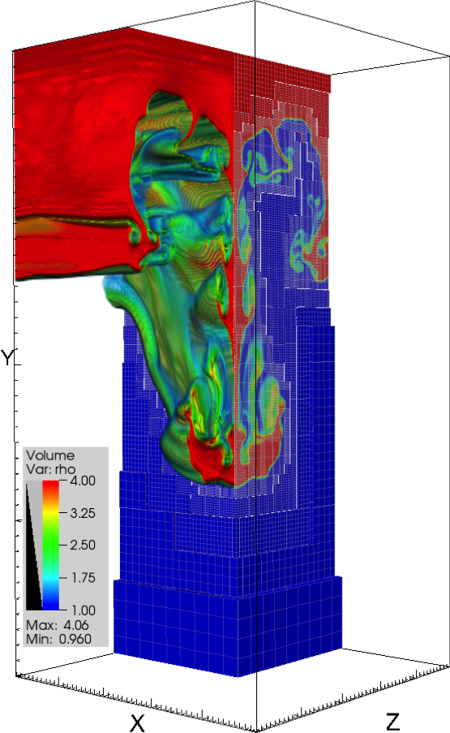
VisIt
Developed by DOE’s Advanced Simulation & Computing Initiative
Continued by DOE’s Office of Nuclear Energy, ASC and Office of Science
Free, open-source
Built upon VTK (which is built upon OpenGL)
Petros Tzeferacos
LLE, 04/23/14

Slide 70
VisIt
A practical walkthrough for the laser-slab problem …
Open the data
Visualize the results
Take a picture
Petros Tzeferacos
LLE, 04/23/14

Slide 71
Outline
What is FLASH?
How do I get the code?
How do I “install” it?
What does it do?
How do I see what it does?
How do I simulate my own experiment?
Petros Tzeferacos
LLE, 04/23/14

Slide 72
The FLASH framework
Infrastructure
Grid
Runtime
Params
I/O
Physics
Monitoring
Hydro
MHD
Profiling
Driver
Gravity
Burn
Logfile
Simulation
Petros Tzeferacos
LLE, 04/23/14

Slide 73
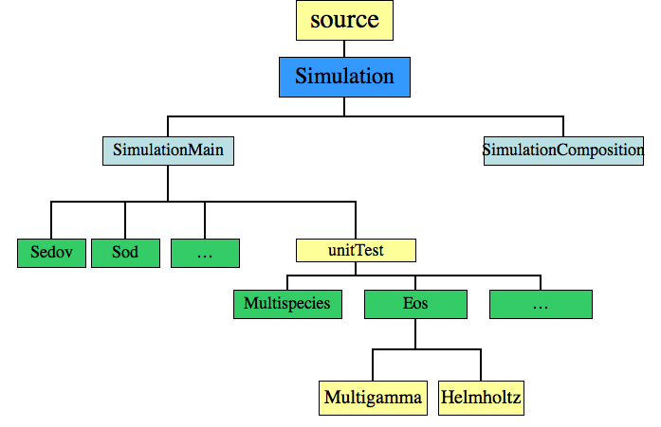
The Simulation Unit
Petros Tzeferacos
LLE, 04/23/14

Slide 74
The Simulation Unit
Typical Unit, obeys architecture, naming conventions, inheritance, etc. rules
Special Unit in that it always “wins” inheritance and parameter wars
FLASH problems is defined by directories in source/Simulation/SimulationMain
The Simulation directory gives people working on a particular problem a place to put problem specific code that replaces the default functionality in the main body of the code
It’s also a place to tell the setup script which units this problem will need from the rest of the code
Petros Tzeferacos
LLE, 04/23/14

Slide 75
The Simulation Directory
Normal UnitMain implementation requirements
  Simulation_data, Simulation_init, (Simulation_finalize), Simulation_initBlock
  Makefile (with usually Simulation_data only)
  Config file
  Possibly other API functions: e.g. Simulation_initSpecies
Specific to simulations:
  Parameter files flash.par, testUG.par, etc.
  Replacements for routines located elsewhere in directory tree
  Routines that implement local functions e.g. sim_derivedVariables
Petros Tzeferacos
LLE, 04/23/14

Slide 76
Required
There are certain pieces of code that all simulations must implement:
  Simulation_data.F90: Fortran module which stores data and parameters specific to the Simulation.
  Simulation_init.F90: Reads the runtime parameters, and performs other necessary unit initializations.
  Simulation_initBlock.F90: Sets initial conditions in a single block.
Petros Tzeferacos
LLE, 04/23/14

Slide 77
Code customization
In a FLASH simulation directory, you can place code that overrides the functionality you would pick up from other code units
In the custom code you can modify:
  Boundary conditions (Grid_bcApplyToRegionSpecialized.F90, or Grid_applyBCEdge.F90)
  Refinement criterion (Grid_markRefineDerefine.F90)
  Diagnostic integrated quanties for output (in the flash.dat file), e.g., total mass (a default) or vorticity (IO_writeIntegralQuantities.F90)
  Diagnostics to compute new grid scope variables (Grid_computeUserVars.F90)
This is a place to hack the code in ways specific to your problem, and you can hack basically anything
Petros Tzeferacos
LLE, 04/23/14

Slide 78
Laser-foil
When starting a new configuration it is convenient to start from an existing setup and modifying it.
Let’s see the files we may need to change…
Petros Tzeferacos
LLE, 04/23/14

Slide 79
Parting words
Use the code freely but responsibly!
Take advantage of the userguide and the webpage material, there is an incredible wealth of info there. flash.uchicago.edu
If you are stuck, send an email to the mailing list! The user community is quite friendly and helpful and the developers at the Center monitor the issues reported and pitch in.
My address: petros.tzeferacos@flash.uchicago.edu
Petros Tzeferacos
LLE, 04/23/14

Slide 80
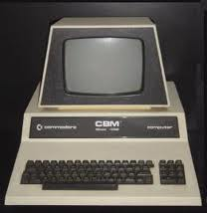

Thanks!
Thanks for listening! Happy coding!
Petros Tzeferacos
LLE, 04/23/14

